Slide 1

DATA ANALYSIS PROJECT
Mutual Fund
Analysis Using R
L.S.S. Manish — 23BDS1098
O. Naveen — 24BDS1083
Faculty: Vijayalakshmi A
Notes:
This project shows how fund data can move from an Excel worksheet to a repeatable screening method in R, ending with a composite investor score.

Slide 2

PROJECT LOGIC
The project turns fund data into a repeatable screening method
01
Start with fund evidence
Scheme-level ratings, categories, and 1-year, 3-year, and 5-year returns.
02
Make the data comparable
Clean and standardize the data in R, then rank funds using weighted performance and rating inputs.
03
Use the result carefully
The output is a screening tool, not a substitute for investor suitability analysis.
02
Notes:
The workflow has three ideas: begin with the available fund evidence, make the fields comparable in R, and treat the result as a shortlist for further analysis rather than a personal recommendation.

Slide 3
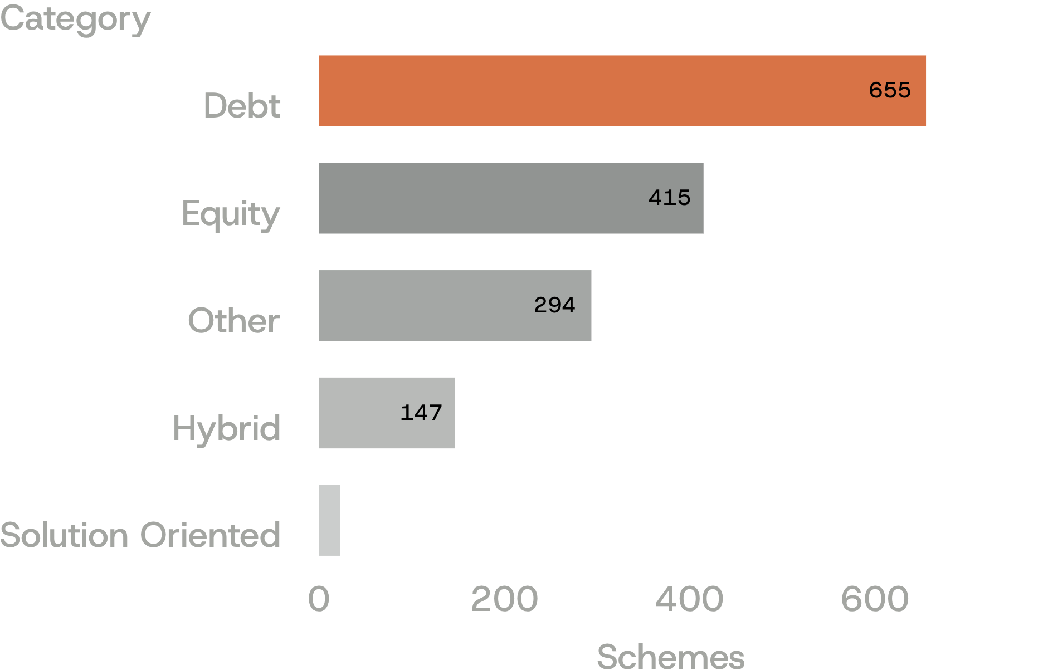
DATASET
The dataset spans 1,534 unique schemes across five broad categories
1,534
unique schemes
Debt and Equity dominate the dataset, while Solution Oriented funds form a small segment.
Five broad categories in the observed universe.
03
Notes:
The dataset contains 1,534 unique schemes. Debt is the largest category at 655 schemes, followed by Equity at 415. Solution Oriented funds form the smallest segment at 23 schemes.

Slide 4
REPRODUCIBLE WORKFLOW
Cleaning makes the analysis reproducible
01
02
03
04
Read
Convert
Deduplicate
Export
Read the Excel worksheet and standardize column names.
Convert ratings and return fields to numeric values.
Remove duplicate scheme names while retaining the first record.
Export cleaned tables, summaries, rankings, and figures for review.
04
Notes:
Reproducibility starts before ranking. The workflow reads the worksheet, standardizes fields, converts ratings and returns, removes duplicate scheme names, and exports the outputs needed for review.

Slide 5
WEIGHTING LOGIC
Long-term history is the most valuable signal in the score
20%
30%
50%
1-year return
3-year return
5-year return
Short-term signal
Medium-term signal
Most valuable signal
The model uses percentile ranks so funds are compared relative to the observed universe.
05
Notes:
The weighting gives the greatest influence to the 5-year return. Percentile ranks make each fund's result relative to the observed universe rather than comparing raw return values in isolation.

Slide 6
COMPOSITE SCORE
The investor score combines performance with rating quality
STEP 01
STEP 02
STEP 03
Percentile scores
Performance score
Investor score
Calculate percentile scores for each return horizon.
Combine them using the 20/30/50 weighting.
80% performance and 20% rating when a rating is available.
80% performance
Eligibility rule
Rank only schemes with a complete 1-year, 3-year, and 5-year return history.
+ 20% rating
06
Notes:
The score is built in stages. First, each return horizon becomes a percentile score. Those percentiles form performance, and performance is blended with the 1-to-5 rating when a rating is available. Complete return history is required for ranking.

Slide 7
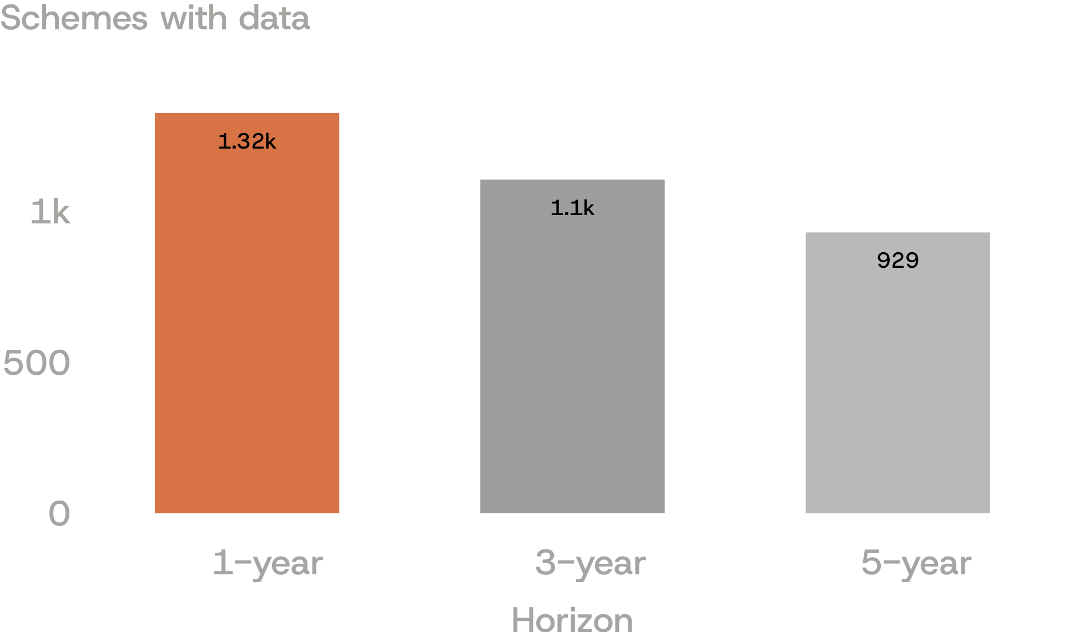
COVERAGE FILTER
Only 929 schemes qualify for the primary ranking
929
primary ranking universe
The complete-history filter keeps the comparison consistent across all three horizons.
The model also flags negative 1-year returns and low ratings as simple risk proxies.
The score, inputs, and exclusion rule are explicit.
07
Notes:
The full dataset is larger than the ranking universe because return coverage falls as the horizon lengthens. The complete-history rule leaves 929 schemes and makes the comparison consistent across all three horizons.

Slide 8
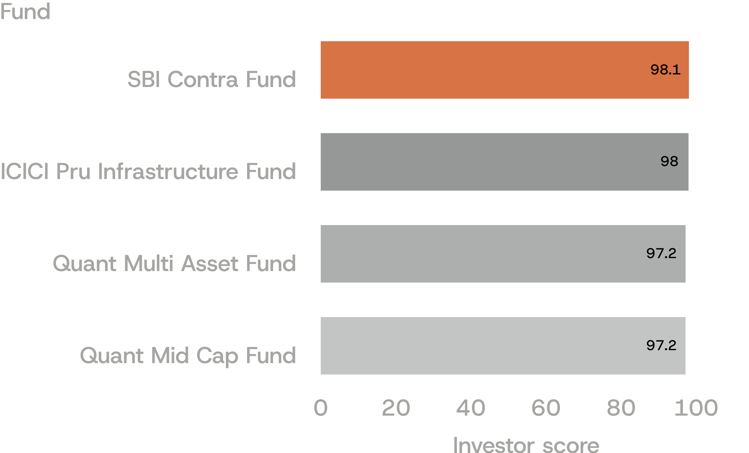
PRIMARY RANKING
The top of the ranking favors strong multi-year performance
Top four funds
1. SBI Contra Fund: 98.08
2. ICICI Pru Infrastructure Fund: 97.97
3. Quant Multi Asset Fund: 97.18
4. Quant Mid Cap Fund: 97.18
08
Notes:
The leading scores are close together. Their return profiles combine strong recent and multi-year performance, while the scoring design gives the greatest influence to the long-term history.

Slide 9
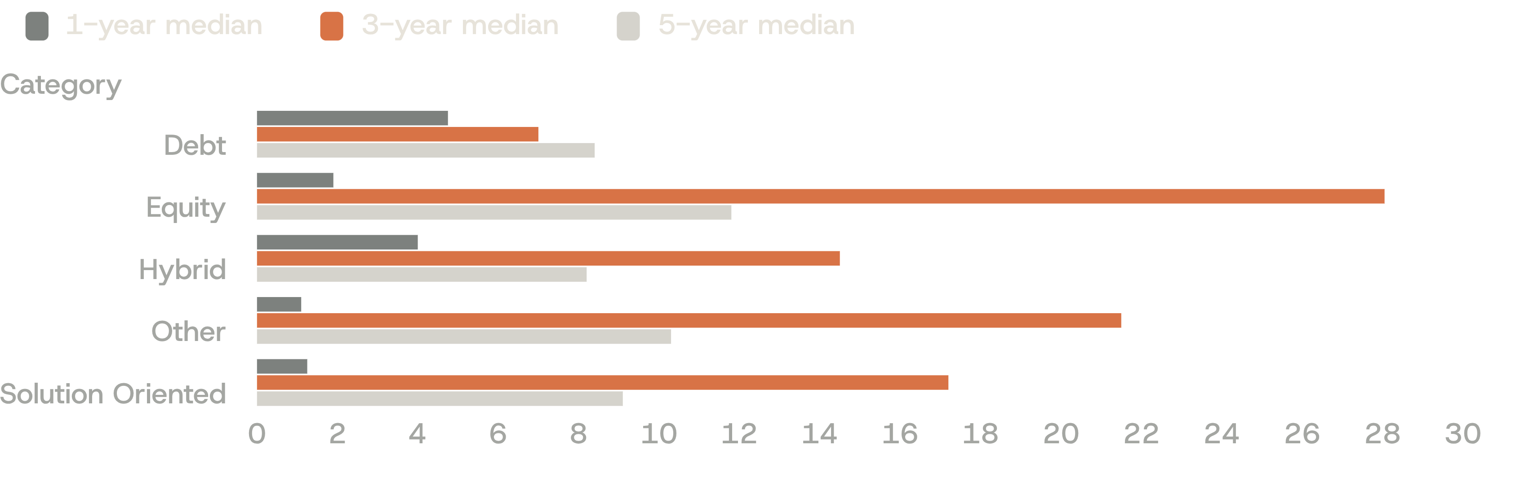
CATEGORY VIEW
Category medians reveal a clear risk-return split
Median returns by category and horizon · Debt shows lower but steadier observed outcomes; Equity leads on 3-year median returns.
09
Notes:
The category medians show the trade-off clearly. Equity leads on the 3-year median, while Debt has lower but steadier observed outcomes, including no negative 1-year returns in the observed rows. Other and Solution Oriented results are more mixed.

Slide 10
What the shortlist leaves open
INTERPRETATION
The model creates an auditable shortlist,
not a final investment decision.
Missing histories reduce comparability and may exclude newer or less-covered schemes.
Next step
Validate shortlisted funds with risk-adjusted measures and investor objectives.
A reproducible R workflow moves from raw spreadsheet data to transparent rankings.
Returns are historical; the score does not include fees, volatility, drawdowns, holdings, liquidity, tax impact, or investor time horizon.
Notes:
Close by separating screening from decision-making. The workflow is reproducible and auditable, but it uses historical returns and leaves out several investor-specific considerations. The next step is validation with risk-adjusted measures and investor objectives.

